Slide 1
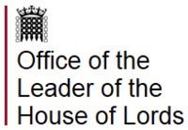
The House of Lords Communications Committee
Teaching children about the internet should be as important as the three Rs, with youngsters given the skills to keep safe online.
The committee's report said: "It is no longer sufficient to teach digital skills in specialist computer science classes to only some pupils.
"We recommend that digital literacy sits alongside reading, writing and mathematics as the fourth pillar of a child's education; and that no child should leave school without a well-rounded understanding of the digital world."

Slide 2
Teaching Online Safety to Children

Slide 3
How to evaluate what they see online - This will enable pupils to make judgements about what they see online and not automatically assume that what they see is true, valid or acceptable.
Schools can help pupils consider questions including:
• is this website/URL/email fake? How can I tell?
• what does this cookie do and what information am I sharing?
• is this person who they say they are?
• why does someone want me to see this?
• why does someone want me to send this?
• why would someone want me to believe this?
• why does this person want my personal information?
• what’s behind this post?
• is this too good to be true?
• is this fact or opinion?

Slide 4
www.Commonsensemedia.org
Common Sense Media helps families make smart media choices. We offer the largest, most trusted library of independent age-based and educational ratings and reviews for movies, games, apps, TV shows, websites, books, and music

Slide 5
One in five 8 to 11 year olds and seven in ten 12 to 15 year olds has a social media profile.
1 in 4 children have experienced something upsetting on a social networking site
1 in 3 children have been a victim of cyberbullying.

Slide 6
What does the Law say Communications Act 2003
Sending by means of the internet a message or other matter that is grossly offensive or of an indecent, obscene or menacing character or sending a false message for the purpose of causing annoyance, inconvenience or needless anxiety is guilty of an offence liable on conviction to imprisonment.

Slide 7
Computer Misuse Act 1990
You can not impersonate or steal someone else’s identity online. This means that writing a status on social media pretending to be your friend, is technically against the law

Slide 8
The Education Act 2011
Be Aware
The Education Act 2011 makes it an offence to publish the name of a teacher who is subject to an allegation until such a time as that they are charged with an offence. All members of the community need to be aware of the importance of not publishing named allegations against teachers online as this can lead to prosecution.

Slide 9
Civil Concerns: Libel and Privacy
Comments made online by anybody could possibly be classed as ‘Libel’ in some cases.
Libel is defined as 'defamation by written or printed words, pictures, or in any form other than by spoken words or gestures'. The authors of such comments can be held accountable under Defamation law, which was created to protect individuals or organisations from unwarranted, mistaken or untruthful attacks on their reputation.

Slide 10
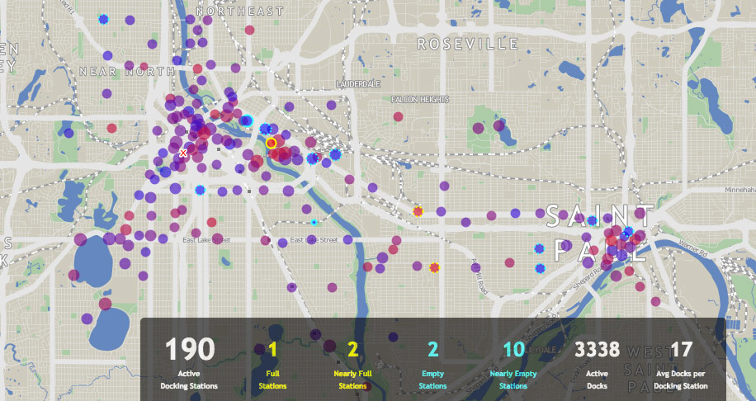
SNAP MAPS
PUT YOUR SETTINGS TO GHOST MODE SO AS NOT TO SHARE YOUR LOCATION WITH OTHER PEOPLE

Slide 11
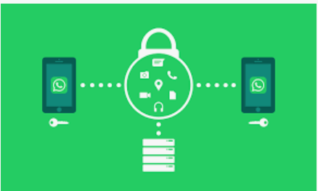
WhatsApp raised the minimum age to use its service from 13 to 16 across the EU in order to comply with GDPR.

Slide 12
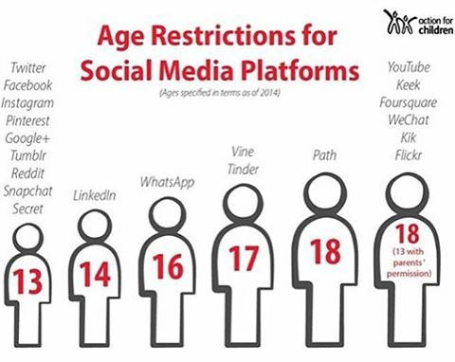

Slide 13
There are good reason for this age restriction to be in place. For example:-
Inappropriate content,
Lack of maturity to use the site safely,
Exposing them to harmful content,
Risk of being contacted by Sexual predators,
Creating an online profile which will be hard to remove in the future,
Placing added pressure on the child to deal with situations beyond their years.
The list goes on but as parents you need to be aware of the safety implications by allowing your child access to Social Media at such a young age.

Slide 14
PEGI
Pan European Games Information

Slide 15
How to find out more about online Games
www.askaboutgames.com

Slide 16
SCREEN TIME
It’s important to pay attention to how children are balancing video games in their lives. Questions like these are useful to consider:
Is my child physically healthy and sleeping enough?
Is my child connecting socially with family and friends?
Is my child engaged with and achieving in school?
Is my child pursuing interests and hobbies?
Is my child having fun and learning in their use of digital media?

Slide 17
PASSWORDS
Very Poor
Excellent
ILOVEYOU
123456
654321
PASSWORD
!”£$%^&*
Sutton123
xCl45vt40
@)&$%”??
D$e*s!k
RugBulbsHelf
ClaWcatfUr
peNmouSepad9I

Slide 18
Google is rolling out the ability for Children, teens and their parents to request to have pictures deleted from the company’s image search results.
Anyone under the age of 18 or their parent or guardian can ask Google to remove an image from appearing in search results by filling out this request form.
You’ll need to specify that you’d like Google to remove “Imagery of an individual currently under the age of 18” and provide some personal information, the image URLs and search queries that would surface the results.

Slide 19
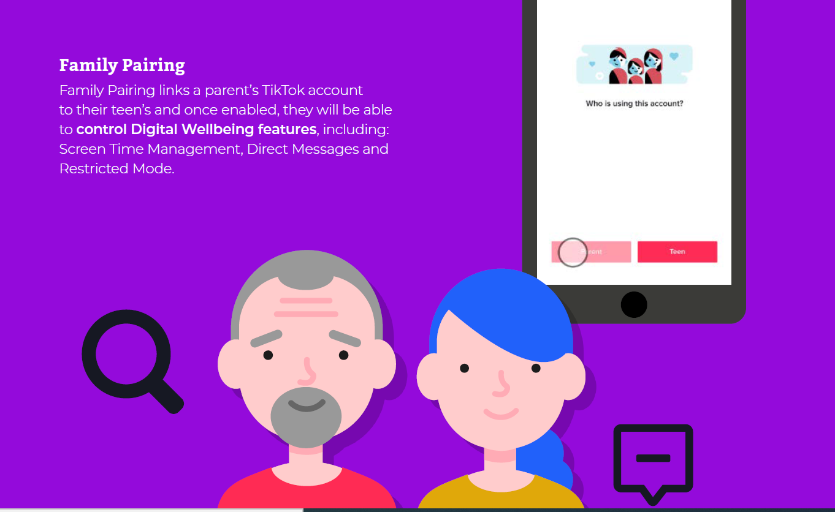

Slide 20
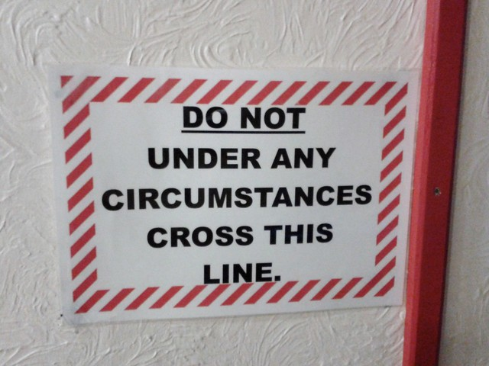
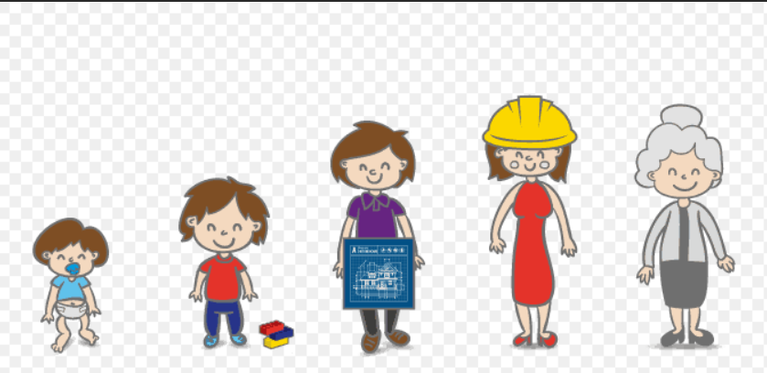
Set Boundaries early
Better Future outcomes

Slide 21
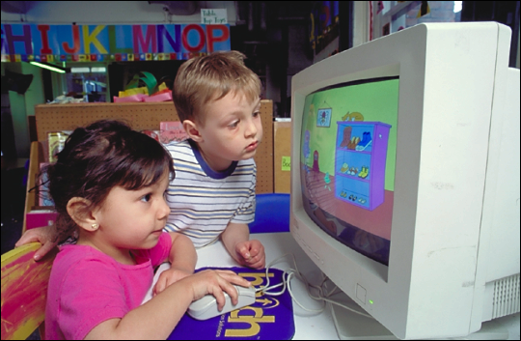
Safe search platforms for Children
There are some search providers designed for children
www.swiggle.org.uk
www.kidclicks.org
www.kidrex.org
www.kidzsearch.com
www.safesearchkids.com
www.factmonster.com
www.gogooligans.com

Slide 22
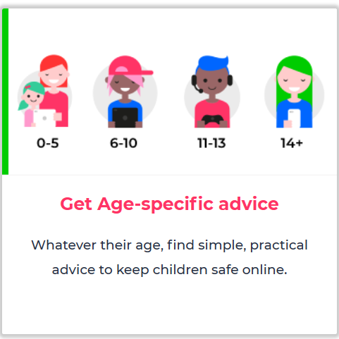
https://www.internetmatters.org

Slide 23
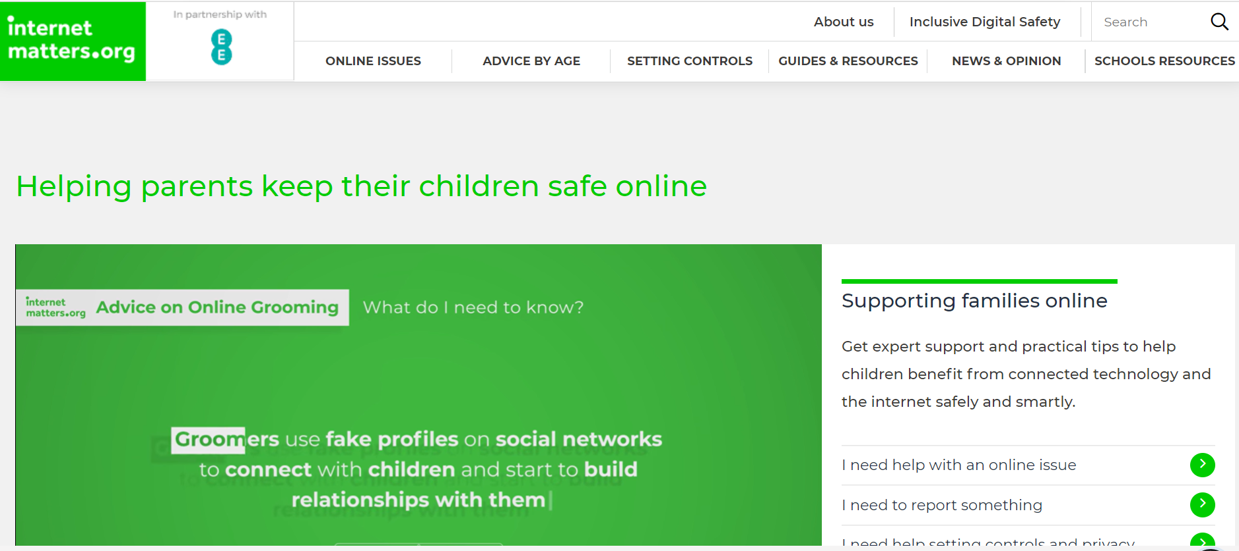

Slide 25
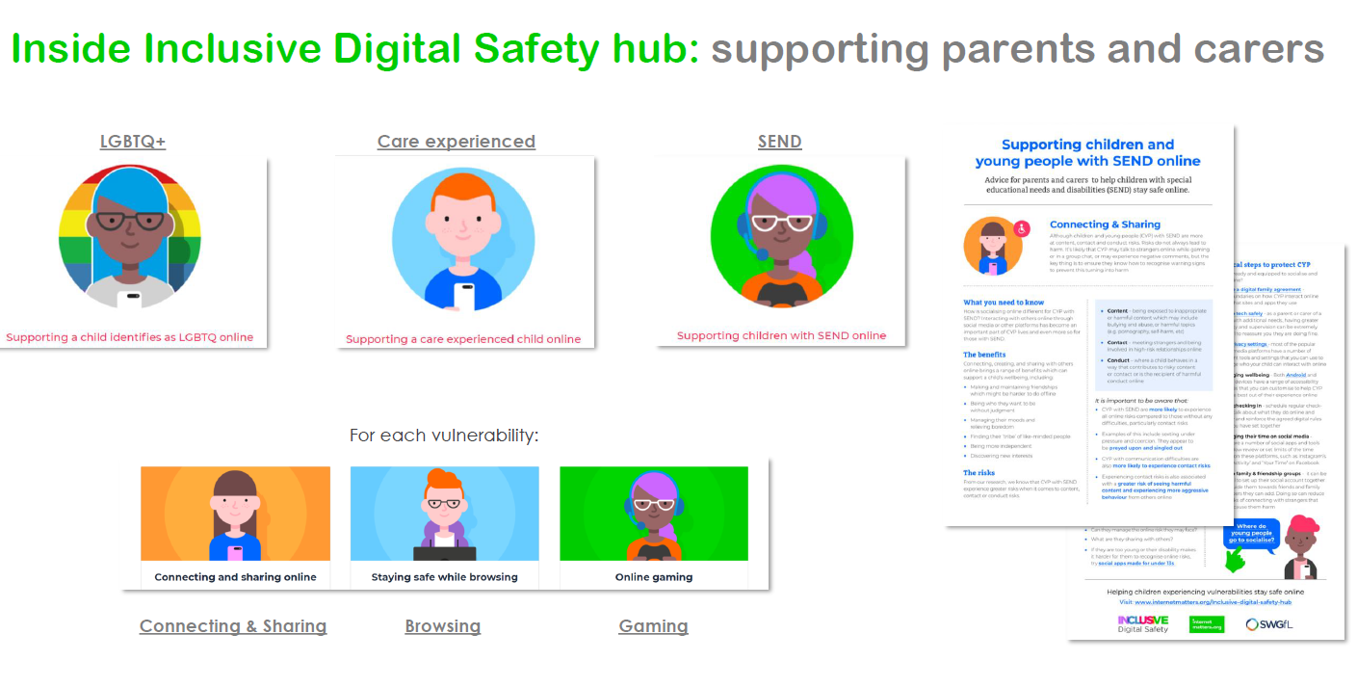

Slide 26
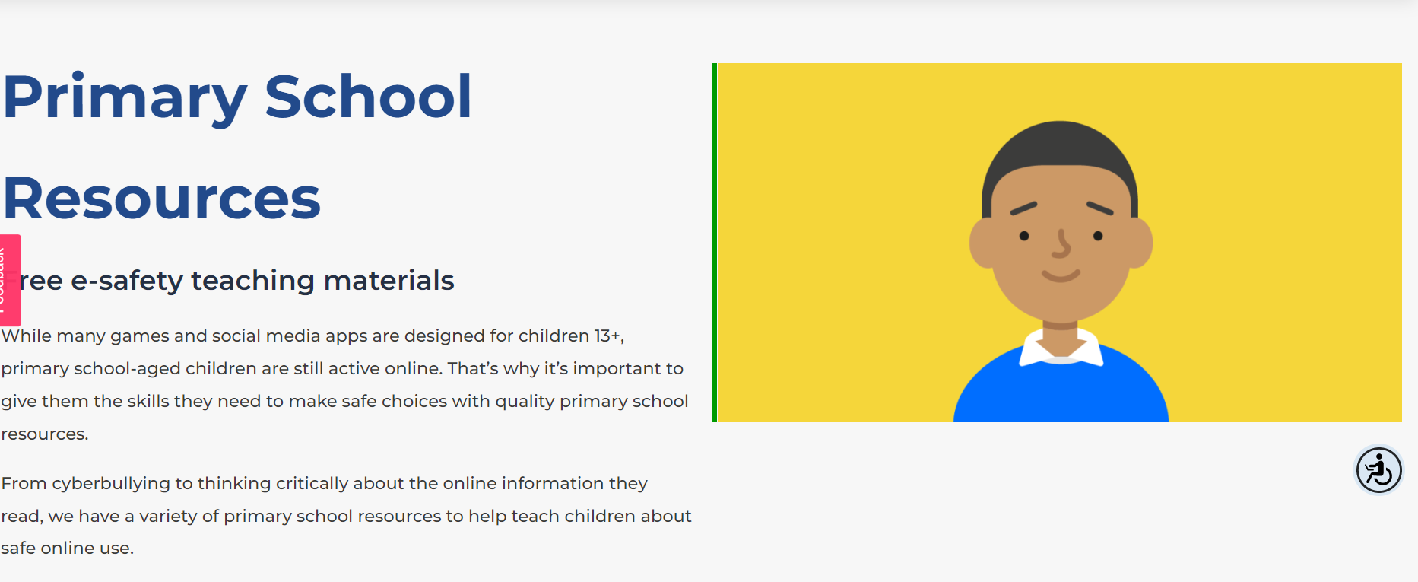

Slide 27
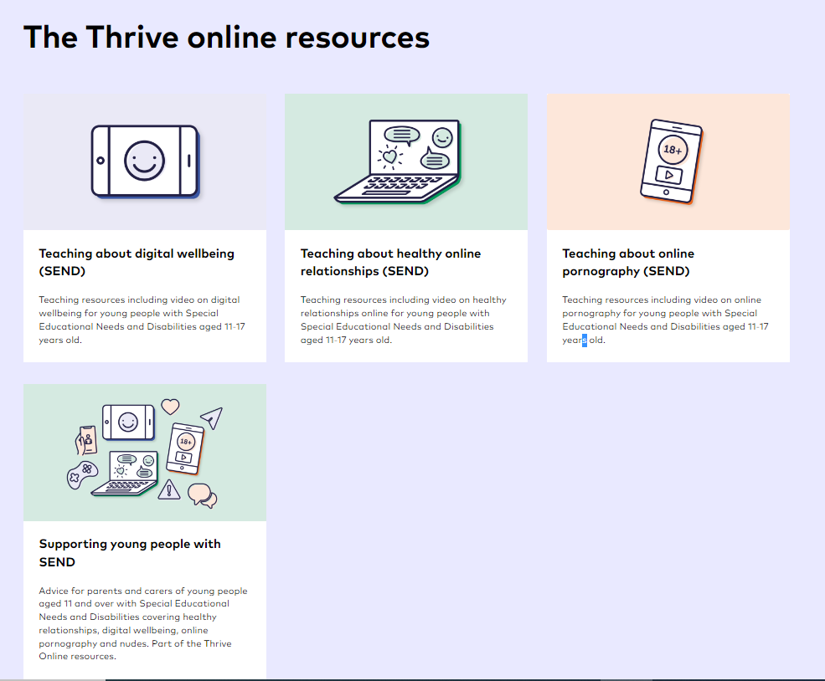
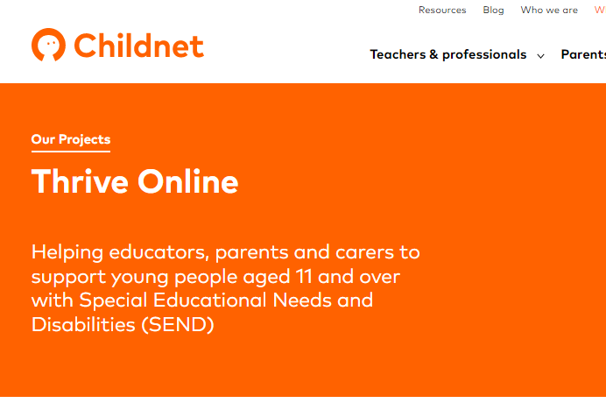

Slide 28
Free Online Safety resources for Year 3 to 7
https://www.childnet.com/resources/digiduck-stories/

Slide 29
Digiduck's Big Decision - the original Digiduck book.
Digiduck's Famous Friend - finding out who their special guest will be at school.
Detective Digiduck - the reliability of online information.
Digiduck and the Magic Castle - a new game that everyone's playing.
Digiduck Saves the Day - positive uses of the internet to help others

Slide 30
Join in with Mummy Penguin’s song and follow the adventures of Smartie the Penguin as he learns how to be safe on the internet.
We provide two versions of the story each for EYFS, Year 1 and Year 2.
The first version of story
covers the following themes:
Pop ups and in app purchasing
Inappropriate websites for older children
Cyberbullying
The second version of the story
covers the following themes:
Upsetting images
Unreliable information
Talking to strangers online

Slide 31
Google Family Link is a way for parents to create a Google account for their children who are younger than 13 years old. This allows the parent to monitor and censor content so that the child is protected, whether it comes to use of apps or online content.

Slide 32
Thinkyouknow CEOP

Slide 33
Youtube for kids app
Easy to set parental controls.
Limit which videos children can watch
Set a time limit
Switch off the search function
Set an age appropriate filter

Slide 34
What can you do now
Search yourself and your children online
Check your and your children’s privacy settings
Use strong passwords
Update software
Think before you post
Review apps and remove any you are not using.
Ensure your child is creating a positive reputation.
operate online in a way which would not cause embarrassment in the future or limit their life chances.

Slide 35
TIPS FOR PARENTS/CARERS
When you buy a game console/Mobile phone/interactive toy, make sure you ask the vendor about its online capabilities. Know what the equipment is capable of.
Think about the location of the game console. Keep it in a common area if possible. A family room is best for monitoring and supervision. Don’t allow children to have internet enabled devices in their bedroom until they reach an age and maturity to keep themselves safe.
Discuss the risks with your child. Don’t wait for something to happen before you talk to your child about the potential risks of gaming online. Ensure they have privacy settings activated and help them to understand why this needs to be done.
Gaming sites/Social Media often have ways of reporting abusive chat and blocking unwelcome contact from other users. – You should know how to do this.
Ask your child what they are playing or what Social Media they are using. Take an interest in your child’s on line life – just as you would if they were in a football team in the real world. Watch them playing and always keep lines of communication open.

Slide 36
Parents need to play their part
Educational settings and professionals should encourage parents to discuss online safety at home and to talk to their child about what they do online. Useful websites to signpost parents/carers to include:
thinkuknow.co.uk/parents
childnet.com
saferinternet.org.uk
parentinfo.org
internetmatters.org
nspcc.org.uk/onlinesafety
commonsensemedia.org
http://www.iwf.org.uk
www.askaboutgames.com
swgfl.org.uk

Slide 37
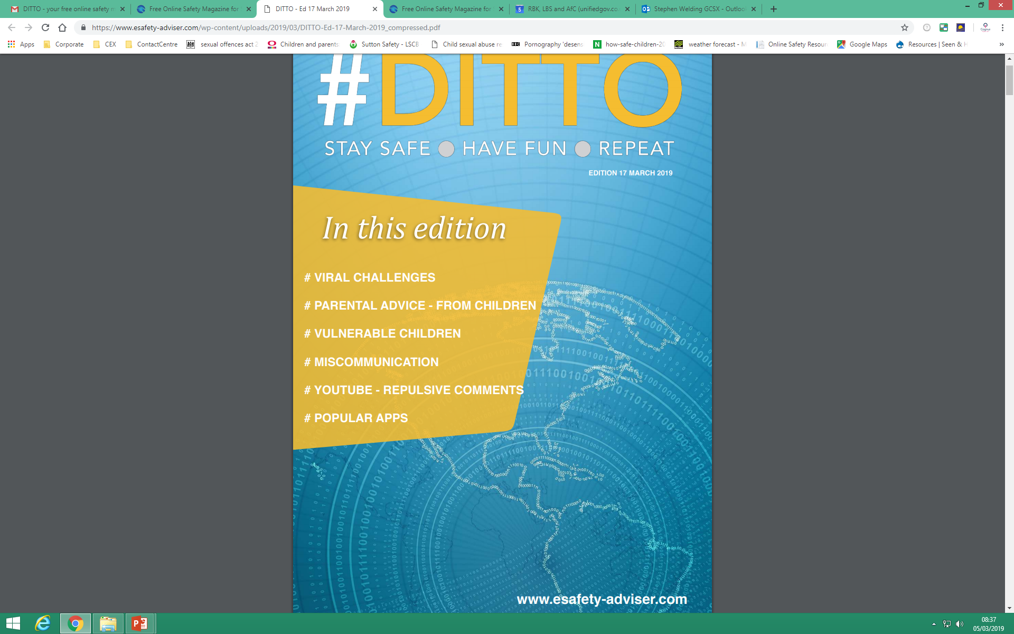
www.esafety-adviser.com

