Slide 1
Rainbow Curriculum Update Autumn 2021 WELCOME
Notes:
Nicki

Slide 2
Our journey since September 2019
Joined the trial of the Government’s new Engagement Model (assessed through Bsquared)
Introduction of PLIMs to more thoroughly address the needs of the pupils and all their EHCP outcomes
More holistic approach to therapy with OT and SALT contributing to PLIMs
Notes:
Sally

Slide 3
At Rainbow we embrace the ethos of children fulfilling their potential, and “being the best they can be”. The importance of ‘learning to learn’ providing teaching and learning experiences to make sure children are ‘ready to learn’ is paramount. This will equip them with a broad range of knowledge and skills to provide a solid foundation to progress through school and life. We recognise that Rainbow children do not develop neuro-typically.
Moving forward…
Notes:
Sally

Slide 4
From September 2021
2021-2 Engagement model will be used to identify how children learn -through exploring, anticipating, realising, persisting and initiating, you will see evidence of this in their observations in their PLIM folders
At the end of a Key Stage school are required to report to the DFE whether a child is working within the engagement model or at the Pre Key Stage Standards
2021-2 After consultation with other settings and further training we have adopted the EYFS curriculum
Small steps of progress will be tracked using B squared (EYFS ‘Birth to Five’) and will be reported at the annual review meeting from Jan 2022
Children can work at their own pace, building their skills within their own capabilities; a child may work across a number of ranges (age brackets) in different areas according to their ability
Teachers can tailor learning more easily to the individual needs of the child.
Notes:
Sally

Slide 5
Pyramid of learning
Becoming ready to learn
Behaviour
Hand eye co-ordination
Motor planning
OT needs: sensory, vestibular, proprioceptive, tactile
Notes:
Sally

Slide 6
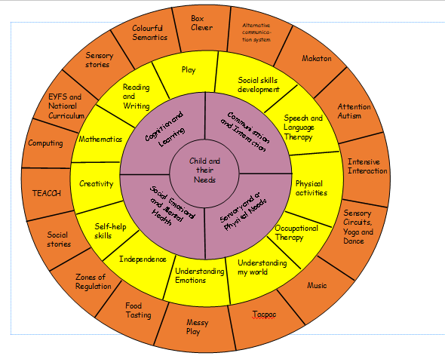
In everything we do:
Child is at the centre
Supported by the four areas of need from the EHCP
This is built on through a variety of strategies and therapies
Tailored into a curriculum unique for each child
Notes:
Rosy

Slide 7
Within the new curriculum learning falls into the following areas:
Communication and Language
Personal Social and Emotional Development
Physical Development
Literacy
Mathematics
Understanding the World
Creative Arts and Design
Teaching will primarily focus on PLIM targets for each child as well as the above
Notes:
Rosy

Slide 8
The Ranges: PSED
B2 summary shows that children learn across many ranges, which we support in school rather than limiting to a specific range. If a child is currently struggling in 1 area (eg speaking) the child’s progress in other areas is shown. These are not ‘closed’ as in future weeks/months/years the progress in the more difficult area (ie speaking) may be achieved. At Rainbow we are always aspirational for our children.
Range 1
Shows their readiness to be social through using their sensory abilities; following movement and gazing at faces intently
Range 2
Shares interest and attention by looking to where the adult is looking, pointing and using their gaze to direct the adult’s attention to something
Range 3
Explores the environment, interacts with others and plays confidently while their parent/carer or key person is close by; using them as a secure base to return to for reassurance if anxious or in unfamiliar situations
Range 4
Shows empathy and concern for people who are special to them by partially matching others’ feelings with their own, e.g. may offer a child a toy they know they like
Range 5
Seeks out companionship with adults and other children, sharing experiences and play ideas
Range 6
Is increasingly socially skilled and will take steps to resolve conflicts with other children by negotiating and finding a compromise; sometimes by themselves, sometimes with support
Notes:
Rosy

Slide 9
Communication and Language: Listen attentively and respond to what they hear with relevant questions, comments and actions when being read to and during whole class discussions and small group interactions. Make comments about what they have heard and ask questions to clarify their understanding. Hold conversation when engaged in back-and-forth exchanges with their teacher and peers. | Personal Social Emotional Development: Show an understanding of their own feelings and those of others, and begin to regulate their behaviour accordingly. Set and work towards simple goals, being able to wait for what they want and control their immediate impulses when appropriate. Give focused attention to what the teacher says, responding appropriately even when engaged in activity, and show an ability to follow instructions involving several ideas or actions. | Physical Development: Negotiate space and obstacles safely, with consideration for themselves and others. Demonstrate strength, balance and coordination when playing. Move energetically, such as running, jumping, dancing, hopping, skipping and climbing.
Maths: Have a deep understanding of number to 10, including the composition of each number. Subitise (recognise quantities without counting) up to 5. Automatically recall (without reference to rhymes, counting or other aids) number bonds up to 5 (including subtraction facts) and some number bonds to 10, including double facts. | Literacy: Demonstrate understanding of what has been read to them by retelling stories and narratives using their own words and recently introduced vocabulary. Anticipate (where appropriate) key events in stories. Use and understand recently introduced vocabulary during discussions about stories, non- fiction, rhymes and poems and during role play. | Understanding the World: Talk about the lives of the people around them and their roles in society. Know some similarities and differences between things in the past and now, drawing on their experiences and what has been read in class. Understand the past through settings, characters and events encountered in books read in class and storytelling. | Expressive Arts: Invent, adapt and recount narratives and stories with peers and their teacher. Sing a range of well-known nursery rhymes and songs. Perform songs, rhymes, poems and stories with others, and (when appropriate) try to move in time with music.
Notes:
Rosy

Slide 10
Year 1 2021-2022
Term Class | Autumn 1 | Autumn 2 | Spring 1 | Spring 2 | Summer 1 | Summer 2
First | Getting to know me | Food glorious food! | Homes | Vehicles | Zoo | Babies
Focus | Mirrors, simple body parts, likes and dislikes, feelings, starting to talk about your family | Exploring food, food tasting, messy and sensory play, using one handed tools | Where do I live? What does it look like? Labelling, windows, doors, roof, garden. Where do different animals live? | Types of vehicles, what they do, how they move, vehicles I see in my world | What animals live in the zoo? Sizes, noises, movement, action songs. Patterns and colours | Human and animal babies. How to care for babies, role play
SRE | Making relationships | Sense of self | Understanding emotions | Making relationships | Understanding Emotions | Sense of self
Then | All about me | Delicious | Buildings and Construction | Transport | Jungle | Growing up
Focus | What I like and dislike. How I feel. My family, friends and my social circle | Exploring and tasting new foods, messy and sensory play, using cutlery | Types of buildings, town and country, uses, constructing, labelling parts of a building | Different types of transport, vehicles in our community e.g. police cars, red buses | What animals live in the jungle? Sizes, noises, movement, action songs. Baby and parent animals | Growing from a baby to a child. What can babies do and what can I do as I grow?
SRE | Making relationships | Understanding Emotions | Sense of self | Making relationships | Understanding Emotions | Sense of self
Next | Me and my Family | Food around the world | Buildings around the world | Travel | Safari | Changes
Focus | Who is in my family? What do they look like? What do other people’s families look like? | Exploring and tasting food from different countries and cultures, using cutlery, mealtimes and traditions | Looking at different countries, cities and their landmarks. What do different houses look like around the world? | Different ways to travel. How different transport moves, where you might see different vehicles and how you might use them | What animals could you see on a safari? What are they like? Baby and parent animals. Why do they live there? | How does my body change as I grow. The human life cycle. Life changes and moving on
SRE | Making relationships | Understanding Emotions | Sense of self | Making relationships | Understanding Emotions | Sense of self
Notes:
Nicki

Slide 11
How this all links together
EHC plan detailing a child’s needs, strengths and areas for development
PLIM written to reflect all the outcomes on the EHC plan shared with parents, therapists and teachers
PLIMs reviewed and then shared with parents termly; new steps set where needed
New end of Key Stage outcomes set at the end of each key stage Transitional Annual Review
PLIMs inform planning and specific interventions in class to support children to achieve their outcomes
Notes:
Nicki

Slide 12
Any questions?
Miss Kidd
Miss Jones
Mrs Cotzias
If watching virtually, please send questions to: Rainbowsen@greenwrythe.org.uk
Notes:
Nicki

